Slide 1
Information for New International Students at Johannes Gutenberg University Mainz

Slide 2
Semester dates
Summer semester: from April to the end of September
Winter semester: from October to the end of March
You can find the current semester dates and lecture times at:
https://www.studium.uni-mainz.de/vorlesungszeiten/

Slide 3
Visa & Entry
Whether you need a visa for Germany as an international student depends on your country of origin and how long you want to stay in Germany. You can obtain BINDING information on visa requirements from the German embassy or consulate in your home country.
https://www.study-in-germany.de/en/plan-your-studies/requirements/visa_26604.php
https://www.auswaertiges-amt.de/en/einreiseundaufenthalt/visabestimmungen-node
https://www.auswaertiges-amt.de/de/ReiseUndSicherheit/deutsche-auslandsvertretungen [In German; German missions abroad]

Slide 4
Proof of funding
Before you can start your studies, you must prove that you have enough money to live in Germany. The necessary amount is currently 10,236 EUR for a year.
https://www.study-in-germany.de/en/plan-your-studies/requirements/proof-of-financial-resources_27533.php
https://www.auswaertiges-amt.de/en/sperrkonto/388600

Slide 5
Registration of residence at the Citizens' Registration Office
In Germany, this registration is obligatory; the place of residence must be registered within 14 days from moving into the apartment. A landlord confirmation, “Wohnungsgeberbestätigung“, stating the day of moving in must be submitted. You can make appointments online here:
Bürgeramt, Abteilung Bürgerservice
Kaiserstraße 3-5, 55116 Mainz
Directly opposite the main station
Bürgeramt, Abteilung Bürgerservice
Kaiserstraße 3-5, 55116 Mainz
Direkt gegenüber vom Hauptbahnhofseingang
https://mainz.de/verwaltung-und-politik/buergerservice-online/buergeramt-online-terminvereinbarung.php
https://mainz.de/en/service/contact.php#SP-grouplist-1-1:5

Slide 6
Foreigners’ Registration Office
Residence permit for international students
Application only possible after registration of residence and with an appointment
(by phone, e-mail or online). Documents
- Valid passport
- Current certificate of enrollment
- Current health insurance certificate
- Current biometric passport photo
- Completed and signed application
- Current proof of financing
(Blocked bank account, declaration of commitment or scholarship)
Bürgeramt, Abteilung für Ausländerangelegenheiten
Kaiserstraße 3-5, 55116 Mainz
Directly opposite the main station
https://www.mainz.de/en/service/contact.php#SP-grouplist-1-1:5

Slide 7
Health insurance
In order to enroll, you need a certificate stating that your health insurance from your home country is also valid in Germany for the entirety of your stay* - or you have to take out a new health insurance.
For EU citizens, the European Health Insurance Card (EHIC) is sufficient for enrollment. If something should happen to you during your stay in Germany (surgery, patient repatriation home), it can quickly become very expensive. Therefore, it is always better to be well insured in advance!
*In this case, you must visit a statutory German health insurance company and have this confirmation issued before you enroll
https://www.study-in-germany.de/de/studium-planen/voraussetzungen/krankenversicherung_27548.php

Slide 8
HEALTH INSURers in Mainz
Here you can find an overview of all the health insurance companies in Mainz:
Techniker KK: Ms Annelie de Marées: annelie.de.marees@tk.de; Ms Jenny Hesper: jenny.hesper@tk.de
AOK: kundenservice.mz@service.rps.aok.de
Barmer: service@barmer.de
BKK24: Mr Emde: mainz@bkk24.de
DAK-Gesundheit: service755700@dak.de
IKK Südwest: Mr Behrendt: michael.behrendt@ikk-sw.de Ms Schmitt: sabine.schmitt@ikk-sw.de
KKH: service@kkh.de
VIACTIV Krankenkasse: service@viactiv.de
vivida bkk: info@vividabkk.de
AOK and TK also have offices on campus.
https://www.study-in-germany.de/de/studium-planen/voraussetzungen/krankenversicherung_27548.php

Slide 9
Getting to JGU (1/3)
FROM THE AIRPORT TO MAINZ CENTRAL STATION (HBF) 1. Frankfurt Airport (30 minutes away) From the Frankfurt airport long-distance train station, tickets for the Eurocity (EC), Intercity (IC) and Intercity Express (ICE) trains cost around € 14. The travel time is approx. 20 minutes. From the Frankfurt Airport Regional train station, tickets for the S-Bahn S8, Regionalbahn (RB), and Regionalexpress (RE) trains cost around € 4.95. The travel time is approx. 30 minutes. Timetables www.bahn.de/p/view/index.shtml
https://www.uni-mainz.de/eng/118.php

Slide 10
Getting to JGU (2/3)
2. Frankfurt-Hahn Airport (Hunsrück region, 90 minutes away) The “Flibco” bus runs from the airport to Mainz main station every three hours . Tickets cost around € 12 and the travel time is around 90 minutes. Timetables www.bohr.de/en/scheduled-services/busline-hahn-mainz Tickets www.flibco.com
https://www.uni-mainz.de/eng/118.php

Slide 11
Getting to JGU (3/3)
Several tram and bus lines run from Mainz main train station to the campus. There are different stops because the campus is very large (all stops on the campus map)
We recommend the tram lines 51, 53, 59, or the bus line 57, as these stop right at the main entrance of the campus.
Bus, tram and train timetables: MVG - Mainz Mobility www.mainzer-mobilitaet.de/ RMV - Rhein-Main-Verkehrsverbund www.rmv.de/c/de/start
https://www.uni-mainz.de/eng/118.php

Slide 12
Living in Mainz and “Wohnen International”
PRIVATE ACCOMMODATION
Visit the following websites if you are looking for a room in a private apartment:
https://www.studium.uni-mainz.de/wohnen/
WG-Gesucht.de
Mitwohnzentrale.de
Wohnungsboerse.de
Facebook groups
The rooms of the Studentenwerk Mainz are run by the “Wohnen International” team. The rooms can be rented for a minimum duration of 6 months. OFFER: The Studierendenwerk guarantees all international students a room if the application is received by the Studierendenwerk by January 15th (summer semester) or July 15th (winter semester).
Application for a dorm room:
Online by the deadline at https://www.studierendenwerk-mainz.de/wohnen/entscheiden-beworben/mietportal/
Confirm your application using the confirmation link (email). Please check your e-mails regularly: You will receive a room offer by e-mail from the Studierendenwerk.
Confirm the room offer within 3 days, otherwise the room will be given to others.
https://www.studierendenwerk-mainz.de/en/internationales/housing-international

Slide 13
Course registration
At Johannes Gutenberg University, all students must register for their courses online via the University Portal JOGU-StINe.
PLEASE NOTE Newly enrolled students in medicine/dentistry are automatically registered for their courses in the first semester.

Slide 14
Course Registration
BEFORE REGISTRATION, you must:
have activated your ZDV account with the ZDV username and the separately sent PUK.
already know which courses you need or want to take. The module handbook that contains this information can be found on the websites of the faculties/study offices. (or you "google it" "e.g. Uni Mainz Modulhandbuch Biologie").
keep the deadlines for course registrations in mind. They are uniformly regulated across the university. Differing registration phases are valid only in degree programs and subjects of the medicine faculty and at the campus Germersheim. Make sure you know the exact dates:
HOW DO I REGISTER?
Log into JOGU-StINe with your ZDV account.
Go to Studies (top)> Modules/Courses (left column)> Registration> Module/Course Registration.
The choice of modules for the corresponding semester should be shown automatically. If you cannot find a module, you can search for it in the course catalog (top)
Call up the module you want to register for and click on "Register". In some degree programs (university medicine), registration for the course implicitly means registration for the exam associated with the course (in this case, a TAN must be entered).
https://info.jogustine.en.uni-mainz.de/registration-periods/course-registration-periods/

Slide 15
Course Choice
In order to get a better idea of which courses you should choose for your first semester, visit the introductory event for your subject and/or contact your academic advisor:
You will also find information for numerous subjects in a separate download.
https://www.studying.uni-mainz.de/introductory-events/
https://www.studium.uni-mainz.de/studienfachberatung/ [academic advisors]

Slide 16
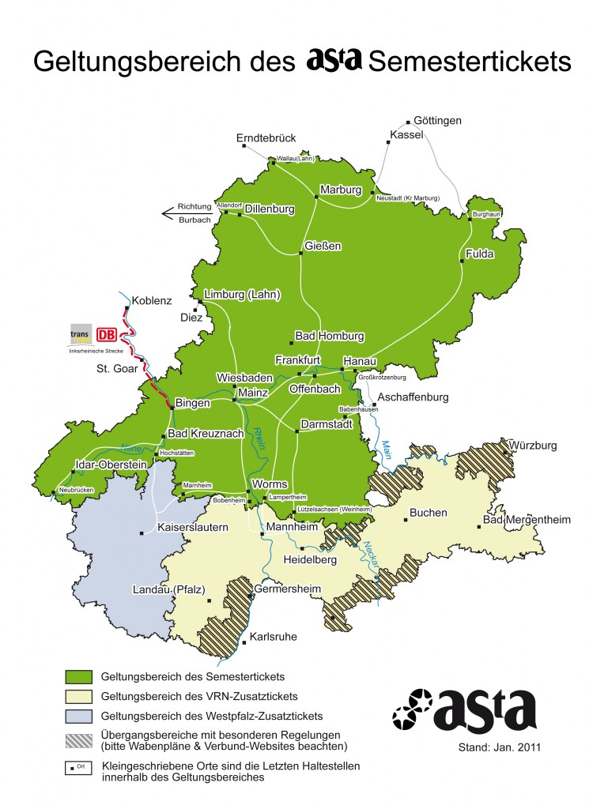
Semester ticket
All enrolled students receive a semester ticket. It is valid as a ticket in connection with an ID or passport. Click on this link to find out what to do if you lose your semester ticket:
www.studium.uni-mainz.de/studienbescheinigungensemesterticket/

Slide 17
Rematriculation
If you wish to continue your studies in the next semester, you will need to re-register with the Student Service Center; i.e. pay the semester fee and any additional tuition fees. Bank details Recipient: Landeshochschulkasse Mainz
BIC: MARKDEF1550 (Bundesbank branch Mainz)
IBAN: DE46 5500 0000 0055 0015 21
Purpose: Student ID number Name (e.g. 1234567 Ulla Musterfrau)
Deadlines Rematriculation for the summer semester is due by January 15 and by July 15 for the winter semester.
The rematriculation and the registration for the courses are both subject to a deadline
https://www.studying.uni-mainz.de/rematriculation/

Slide 18
Student Services
The Student Service Center is the central access point for current and prospective students and offers a wide variety of information, orientation guides, and advisory services.
So, if you need general, non-subject-specific information about your studies - for example about changing subjects, leave of absence, or exmatriculation – you can contact the Student Service Center by phone: + 49 6131 39 22 122 (Mon-Fri 9 a.m.-12 p.m., Mon-Thu 1-4 p.m.) or by email at studsek@uni-mainz.de.
https://www.studying.uni-mainz.de/service/

Slide 19
International office
The International Office is the first and central point of contact for all international students in matters requiring advice and support.
There is also a contact person for general information on residence and employment law. They will also help you if the Foreigners’ Registration Office questions the progress of your studies. You can reach them at: service@international.uni-mainz.de
* The international student desk is also located within the Student Service Center. Appointments can be made here to speak with an advisor, if necessary.

Slide 20
The President’s Advisor for International Students
Contact Prof. Dr. Goldt, the president's advisor for international students, if organizational or personal problems arise in your studies, you need support in contacting authorities such as the immigration office, want to change your subject, or encounter other serious problems in your student life.
Contact and office hours:
https://www.international-office.uni-mainz.de/the-presidents-advisor-for-international-students/

Slide 21
ASTA
Political educational work is carried out, a student-friendly semester ticket is guaranteed, and socially disadvantaged students can find support here. Political and cultural events and free legal advice are also offered. The AStA consists of different sections. The foreigners’ department is particularly important for you. The department stands up for the interests and concerns of international students at the University of Mainz and supports them in the process of integration on campus and in society by organizing cultural events: workshops, seminars, and a TextCafé.
Find out more:
asta.uni-mainz.de/vs/asta/auslaenderinnen

Slide 22
Buddy Program
What is the Buddy Program?
The buddy program is an offer from the Studierendenwerk. It brings international and German students together. In 1: 1 contact, international students can explore the city together with their German buddy, get coffee, meet friends, speak German, and much more. In addition, the Studierendenwerk's buddy program regularly organizes events, excursions and workshops for participants in the program, e.g. cooking events or a monthly get-together.
How to become a Buddy
You can register online under: https://bit.ly/2AoSln4 Various questions will be asked to help find a suitable buddy.
https://www.studierendenwerk-mainz.de/en/buddy

Slide 23
Fremde werden freunde
What is Fremde werden Freunde?
This is also an offer from the Studierendenwerk with the aim of bringing together citizens from Mainz and the surrounding area and international students. In order to experience German citizens’ everyday life of, contact with German students is not enough, because student life differs from the everyday life of "normal" citizens.
How can I register? You can register online under: https://www.studierendenwerk-mainz.de/internationales/freunde-haben/fremde- wird-freunde/anmeldung/anmeldung-studis
https://www.studierendenwerk-mainz.de/en/internationales/making-friends/foreigners-become-friends

Slide 24
Sprachcafé
You can brush up on your foreign language skills here, meet new people and learn more about the country and culture.
The principle is simple: different languages are spoken at different tables. The language table instructors are always there, and they prepare a new, exciting topic for each week. The language café is free and works without registration.
Due to the corona pandemic, the Sprachcafé will take place online this semester: During the lecture period every Wednesday from 6 p.m. to 8 p.m. Simply log in to https://discord.com/invite/f2F4Fu5 and take part!

Slide 25
Office of AccessIbility
If you have a disability, are chronically ill or have a mental illness, the Office of Accessibility can support and advise you regarding personal problems, problems with your studies, legal questions, organization or financing.
Due to the current Corona-Virus outbreak, the Office is closed for walk-in consultations and can only be contacted via telephone (+49 6131 39-23085) and e-mail (barrierefrei@uni-mainz.de). Consultations can be offered via telephone or video-chat.
https://accessible.uni-mainz.de/

Slide 26
BICYCLING IN MAINZ
Do you want to buy a bike? It’s best to take a look at portals such as ebay-Kleinanzeigen, notices on notice boards or check the Unibike shop.
Rental bikes In order to use the Mainz city bikes, you must register online.
https://www.mainzer-mobilitaet.de/mehr-mobilitaet/meinrad

Slide 27
Johannes Gutenberg University Mainz International office Welcome extracurricular program for international Students
service@international.uni-mainz.de

